Slide 1
Digital Portfolio
Sagar Maheshwari
20Bai10339

Slide 2
Subject Knowledge
Introduction to Problem Solving and Programming (CSE1021) [Python, Problem Solving, Fundamental Algorithms, Factoring Methods, Array Techniques]
Fundamentals in AI & ML (CSA2001) [Problem Solving Approach to Typical AI problems, Knowledge Representation, Software Agents and Prolog, Introduction to ML]
Object Oriented Programming with C++ (CSE2001) [Object Oriented Approach, Classes and Objects, Polymorphism and Inheritance, Exception handling]
Applied Machine Learning in Python (CSA4008) [Supervised/Unsupervised Learning, Ensemble Learning, Reinforcement Learning]
Computer Architecture & Organization (CSE2003) [Computer Architecture, Data Representation, Memory System, External Storage Systems]
Computer Networks (CSE3006) [Networking and its layers, Principles of Networking Applications, Network Security]
Reinforcement Learning (CSA3003) [Introduction to RL, Probability Primer, Prediction & Control by DP]
Convex Optimization (CSA3002) [Introduction to optimization, Convex Optimization: Algorithms and Applications]

Slide 3
Artificial Neural Network (CSA4002) [Introduction to Neural Networks, Learning Process, Single/Multi Layer Perceptron's]
Deep Learning (CSA4004) [Intro to DL, Machine Learning, Advanced Neural Networks, Optimization on Deep Models]
Natural Language Processing (CSA4006) [Knowledge in Speech and Language Processing, Morphology And Finite-State Transducers, Syntax Parsing]
Data Structures & Algorithms (CSE2002) [Introduction to Algorithm and Data Structures, Sorting and Searching, List, Stack and Queue, Trees and Hashing]
Theory of Computation & Compiler Design (CSE2004) [NFA, DFA, Context Free Grammar, Parsing, Turing Machines]
Database Management Systems (CSE3001) [Introduction to Database system, Relational Models, PL/SQL, Transaction Management]
Operating System (CSE3003) [Basic of Operating System and Its Structures, Process and Threads, Processor Scheduling and Deadlocks, Memory and Storage Management]
Design & Analysis of Algorithms (CSE3004) [Advanced algorithmic analysis, Problem solving strategies, Geometric algorithms]
Engineering Design (DSN2096) [Design Thinking for Innovation, Engineering Design Approaches, Prototyping and Visualization]

Slide 4
Electric Circuits And Systems (EEE1001) [Electric Circuits, AC Circuits Analysis & Magnetic Circuits. Digital and Logical Systems]
Digital Logic Design (ECE2002) [Digital Logic Design Fundamentals, Combinational Logic DesignRegisters, Counters & FSMs]
Applied Linear Algebra (MAT3002) [Linear Equations and Matrices, Vector Spaces and Subspaces, Linear Transformations]
Discrete Mathematics And Graph Theory (MAT2002) [Set Theory and Boolean Algebra, Predicate Calculus, Fundamentals of graphs, Matrix representation of graphs]
Calculus And Laplace Transforms (MAT1001) [Partial derivatives, Multiple Integrals, Vector Calculus, Differential equations]
Logic And Language Structure (HUM1012) [Introduction to Natural Language Processing, Syntax and Semantics Interface in Natural Language, Logic in Natural Language and understanding Natural Language semantics]
Ethics And Values (HUM1001) [Theories of Ethics, Role of employees and Ethics in work place, Corporate Governance and Ethics]
Technical Writing And Composition (ENG2001) [Fundamentals of Writing, Writing Practices, Professional & Business Correspondence]
Communication for Technical Professionals (ENG1001) [Dynamics of Communication, Rules and Usage of Language, Strategic Reading]

Slide 5
Introduction to Computation Chemistry (CHY1005) [Quantum Chemistry, Potential Energy Surfaces, Molecular Dynamics]
Environmental Science (CHY1002) [Ecosystem, Biodiversity, Environmental pollution and climate change, Natural Resources ]
Statistical Inference and Series of Functions (MAT3017) [Estimation, Methods of Estimation, Testing of Hypothesis, Sequences]
Stochastic Process (MAT3016) [Introduction to Stochastic Processes, Classification of States and Chains, Markov Processes with Discrete State Space]
Engineering Physics (PHY1001) [Quantum Physics, Nanophysics, Laser]
Programming For Computing Engineers (PLA1001) [Object and Class, Data types, Basic I / O, Decision Making, Loop Control, String, Date, Array, Inheritance]
Programming For Engineers (PLA1002) [Object and Class, Control statements, Association and Modifier]
Logic And Problem Solving For Engineers (PLA1003) [Logic Basics, Data interpretation, Verbal basics, Logic - Time]
Soft Skills for Engineers – I (SST1002) [Introspection / Self-Management, Resume Writing, Social Interaction, Building Verbal Ability]
Soft Skills for Engineers – II (SST2002) [Communication, Interview Skills, Art of Questioning, Team Dynamics]

Slide 6
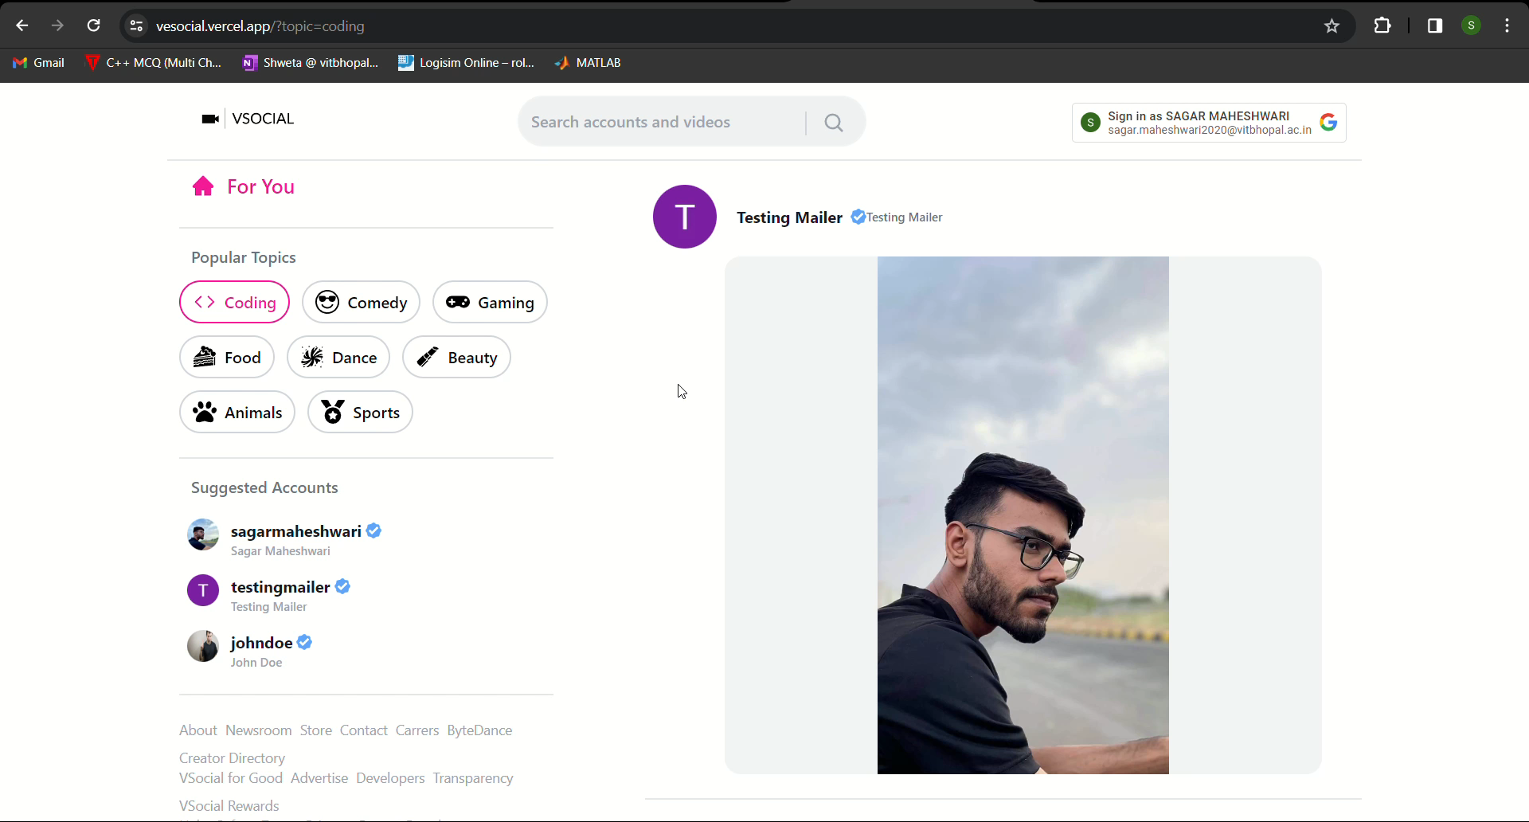
Project Knowledge
V-Social (July 2022)
Developed a cutting-edge social media platform optimized for sharing short-form videos.
Technology Used: MERN stack, sanity studio (for uploading videos), JavaScript (Programming Language)
Link: VSocial
GitHub: GitHub-Vsocial

Slide 7

ProShop (July’21 – Aug’21)
Created a robust e-commerce platform with PayPal integration for seamless and secure payment processing.
Technology Used: MERN stack, Redux (for state management), JavaScript (Programming Language)
GitHub: ProShop

Slide 8
Programming Knowledge
These are the programming languages learnt in B.Tech :-
Java
Python
C++
SQL

Slide 9
CV
Portfolio link: Portfolio

Slide 10
About myself
I am a final year Computer Science and Engineering student at VIT Bhopal who is passionate about learning new technology,
A lifelong learner who likes to build applications which are going to be used by millions.

Slide 11
education
Kendriya Vidyalaya, Beawar (2017-2019)
Allen Career Institute, Jaipur [JEE-Preparation] (2019-2020)
Vellore Institute of Technology, Bhopal (2020-Ongoing) – B.Tech CSE with specialization in Artificial Intelligence and Machine Learning

Slide 12
Technical Skills
Database Management
Full Stack Web Development (MERN)
Coding (C++)
React.js, Next.js, Express.js, Node.js, MongoDB, Redux, Context API, Bootstrap, Tailwind CSS, Material-UI, JavaScript
GitHub: https://github.com/SagarM21

Slide 13
Work experience
Arishti CyberTech (Full Stack Developer, September’22 - Present)
Building a secure chat web application with the MERN stack, establishing bi-directional communication with the mobile app.
Revitalized the admin panel, introducing agile features such as an audit module and KMS keys, resulting in an impressive 70% increase in efficiency.
Strengthened security and integrated the Stripe payment gateway while fortifying the admin panel against NoSQL injections with rigorous client-server validations.
Doosra College (Frontend Developer, July’22 – August’22)
Developed a comprehensive website entirely from scratch, utilizing Next.js as the framework, and JavaScript for programming.
Utilized tailwind CSS for styling, framer motion, and other top- tier npm packages to ensure the highest quality of design and functionality.
Froshlink (React Developer, September’21 – December’21)
Employed advanced web development techniques, including NextJS and Typescript, to enhance and modernize the existing codebase, resulting in decrement of error rate by less than 5%.
Crafted tailor-made React components for the website's Resume section, employing top-tier tools and technologies for optimal performance and user experience, additionally, used Material-UI and Tailwind CSS.

Slide 14
Soft skills
Communication
Interpersonal Skills
Time and Project Management

Slide 15
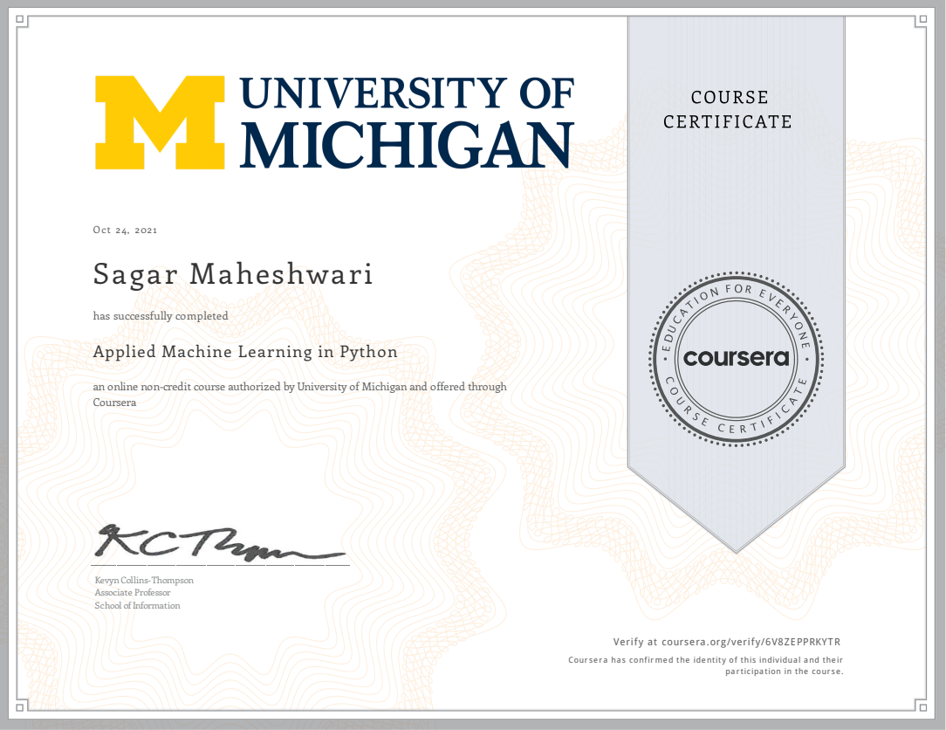
certifications
Applied Machine Learning in Python Course

Slide 16
Personal information
LinkedIn Profile
https://www.linkedin.com/in/sagar-maheshwari-3330b6166/
Mail ID
sagar.maheshwari2020@vitbhopal.ac.in

